Slide 1
Micropython for Mews
Sev Leonard
PyDX 2016

Slide 2
Acknowledgements
Joe Fitzpatrick @securelyfitz
micropython.org
Countless githubs and blogs
github.com/mcauser/MicroPython-ESP8266-Nokia-5110-Conways-Game-of-Life
github.com/garybake/upython_wemos_shields

Slide 3
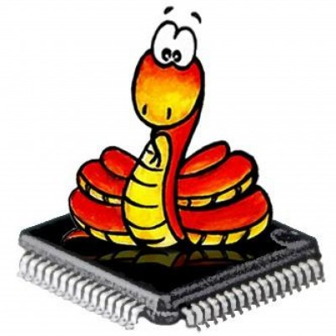
What is Micropython?
Like regular Python, but small and hard to read
A version of Python optimized for use on microcontrollers
Funded via Kickstarter
All of the above
Some of the above
E. Some of the above!
micropython.org
Notes:
I first heard about micropython this may at PyCon and I thought it sounded really rad.
I played with microcontrollers in college, but that was a long long time ago, so Ive basically forgotten everything
So im hoping that by sharing my experience floundering through hardware and micropython will help others new to these topics jump in and play with things

Slide 4
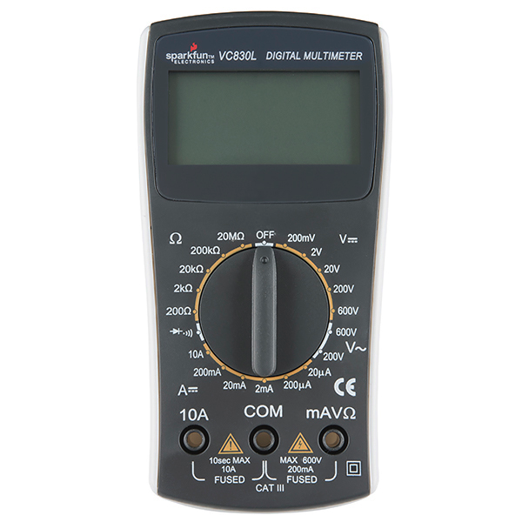

Some things about hardware
It’s hard
Microfractures are a real pain
Costs $$
May result in hair loss
May also result in delighted squeals
pdxhackerspace.org
Notes:
Sparkfun multimeter $15

Slide 5
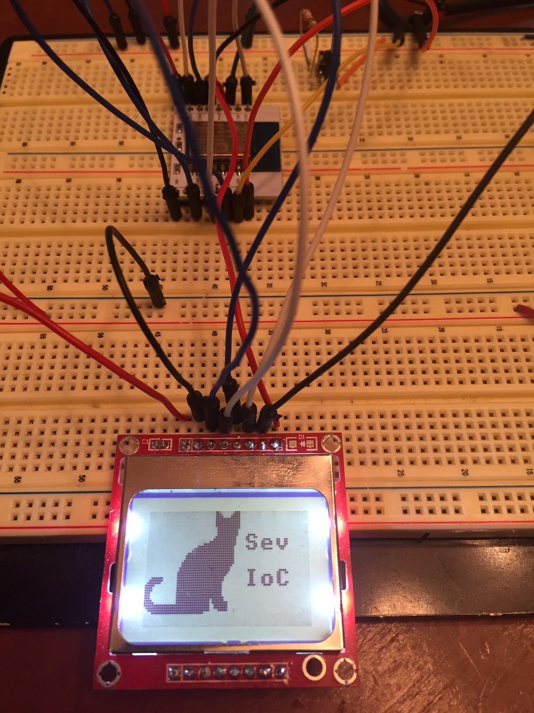
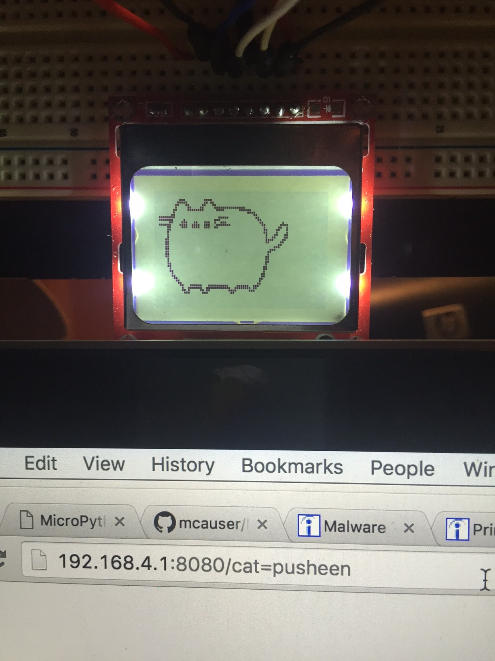
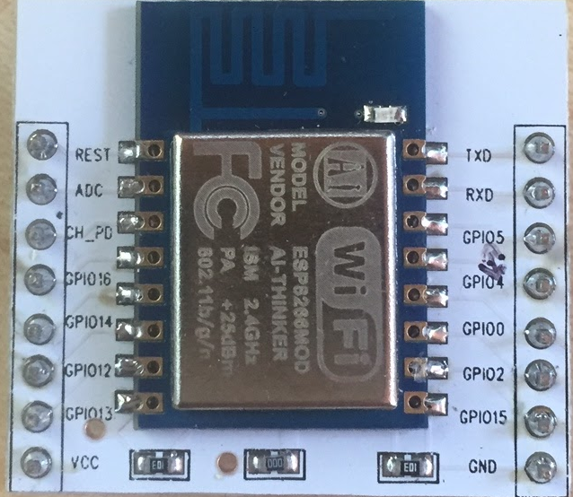
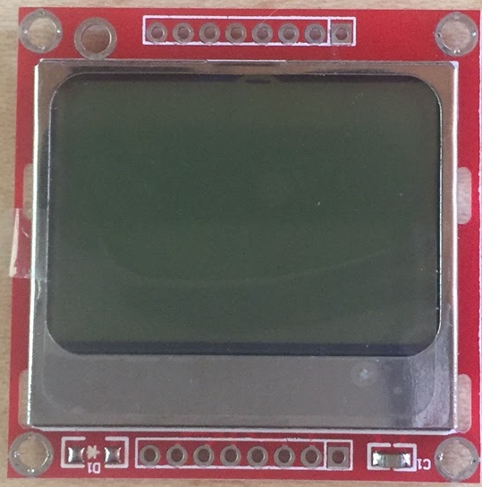
The Internet of Cats
Serving up 1-bit cat pics since 2016
ESP8266
Nokia 5110
Notes:
Specifically the ESP-12, ESP8266MOD AI-THINKER
Nokie 5110 LCD

Slide 6
Material costs
ESP8266: $2 - $6
Nokia 5110 LCD: $3
Multimeter: $15 from Sparkfun
FTDI USB to TTL serial cable: $2 - $10
Jumper wires: $6
$30 - $40

Slide 7
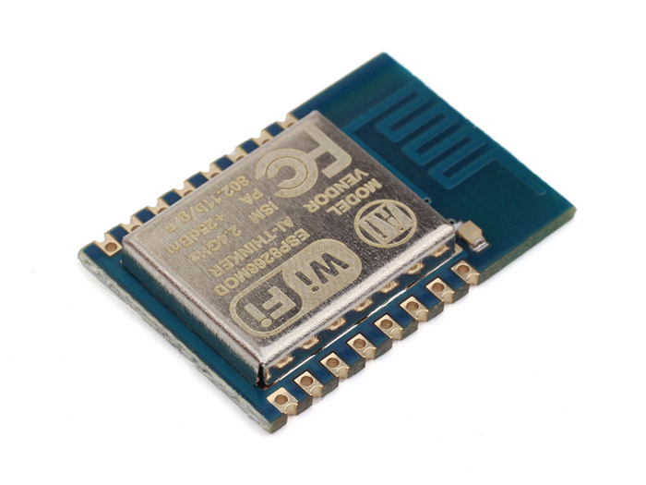
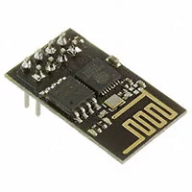
The ESP8266
3.3V supply
May require extra ‘juice’ beyond what your USB port can deliver
Limited to ~25Kb memory
There are many configurations of the ESP8266!
ESP-12
ESP-01
Notes:
BOARD IS NOT 5V!!!
Board can go as high as 140mA. Changing cables Im seeing some instability that may be amperage related? unsure.
Heap ram is limited to about 25kB (where your program / data is stored)

Slide 8
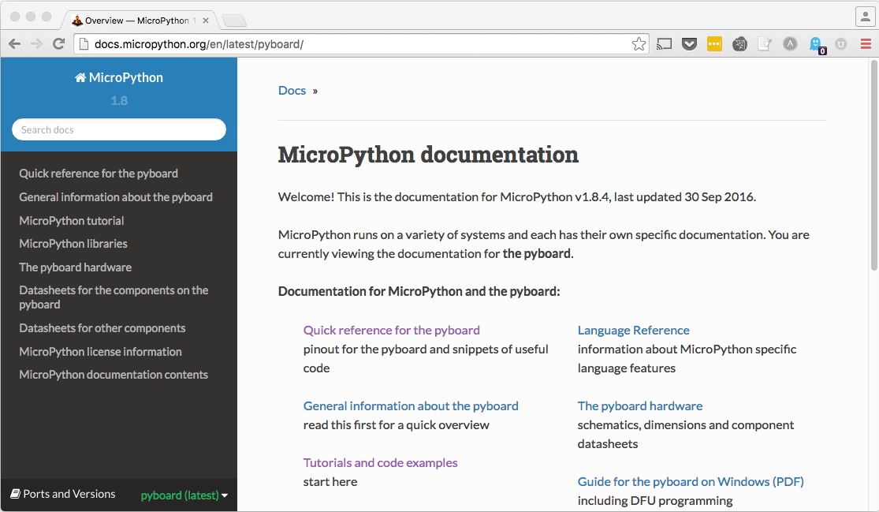
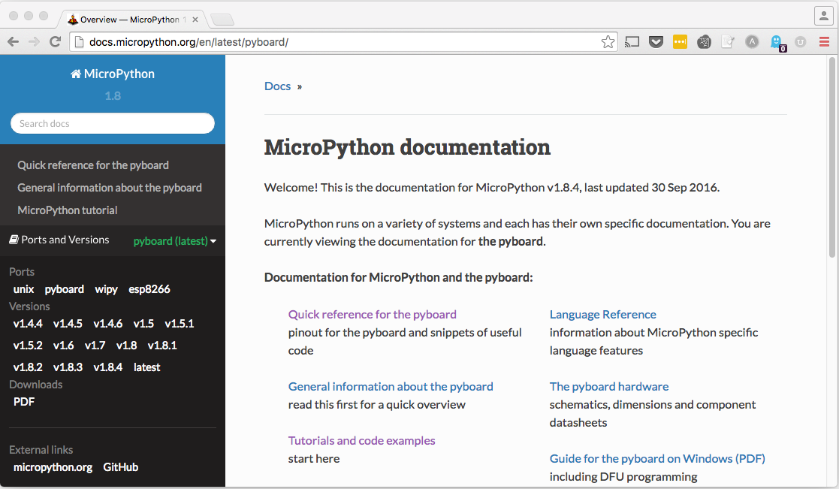
What boards can I use?
http://docs.micropython.org/
Notes:
Micropython runs a few specific microcontrollers. To find out which ones go to the docs page, and click the ‘Ports and Versions’ tab in the lower left hand corner. The Adafruit HUZZAH! Board is an example of a ESP8266 board that has some excellent documentation

Slide 9
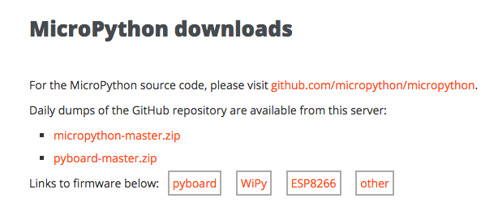
How do we teach the board micropython?
micropython.org/download
github.com/themadinventor/esptool/
pip install esptool
Notes:
First we need to get micropython firmware that has been built for our target, the ESP8266
Then we need to load the firmware onto the board itself using esptool.
The docs and tutorials are a good reference, but tend to be high level and oriented toward breakout type boards and not bare components, i.e. the Adafruit HUZZAH as opposed to just the ESP8266 on its own

Slide 10
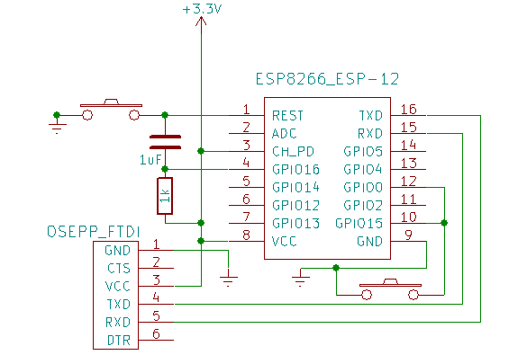
Loading the firmware
Source: http://www.agcross.com/2015/09/the-esp8266-wifi-chip-part-3-flashing-custom-firmware/
Notes:
Need to set the board up in bootmode to load firmware - tie GPIO0 and GPIO5 to ground, make sure chip enable (CH_PD) is high

Slide 11
Flashing the board
esptool.py --port /dev/ttyUSB0 erase_flash
esptool.py --port /dev/ttyUSB0 --baud 460800 write_flash --flash_size=8m 0 esp8266-2016-05-03-v1.8.bin
“A fatal error occurred: Failed to connect to ESP8266”
Unplugging/replugging in the ESP8266 seemed to fix the problem

Slide 12
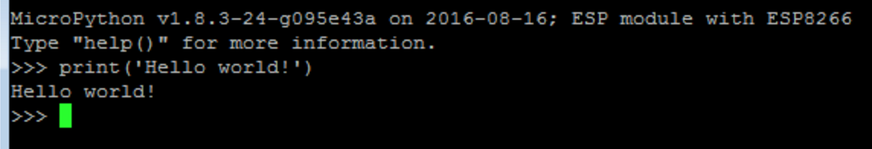
REPL time!
REPL - read, evaluate, print loop. In other words; a command line shell
> screen /dev/ttyUSB0 115200
Notes:
Can also use minicom or picocom

Slide 13
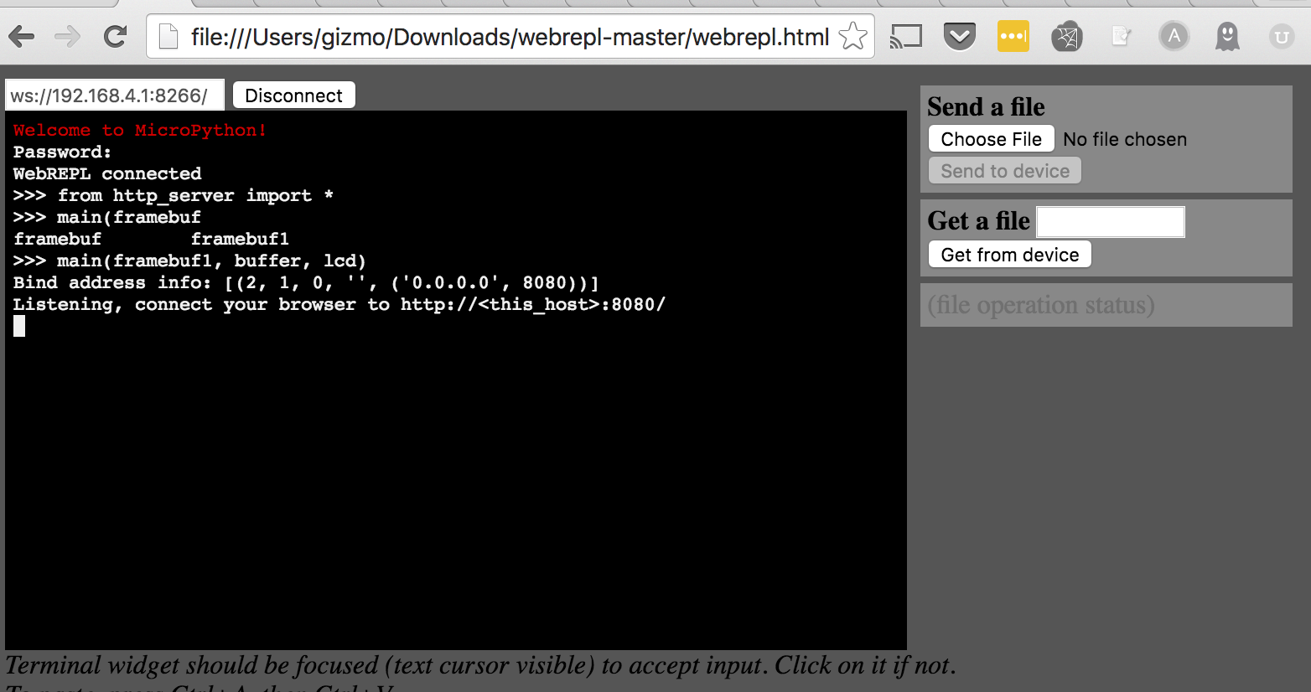
Web REPL
Notes:
First time you will need to set a password. I found it was finicky if I used symbols or anything over a handful of characters
Great for sending files

Slide 14
Web REPL tips
Enable in boot.py if not memory constrained
Make sure you can see the wifi network!
Notes:
For some reason the chromebook wasnt reliably picking up the wifi signal from the ESP8266, I could see it from my MacBook just fine and was able to program from there
Really great if for some reason your cable is finicky (like my experience)

Slide 15
Collecting garbage
from machine import Pin, HSPI
import gc
import upcd8544
gc.collect()
import framebuf
import math
gc.collect()
Notes:
For dealing with memory constrained environment clean up after yourself frequently!

Slide 16
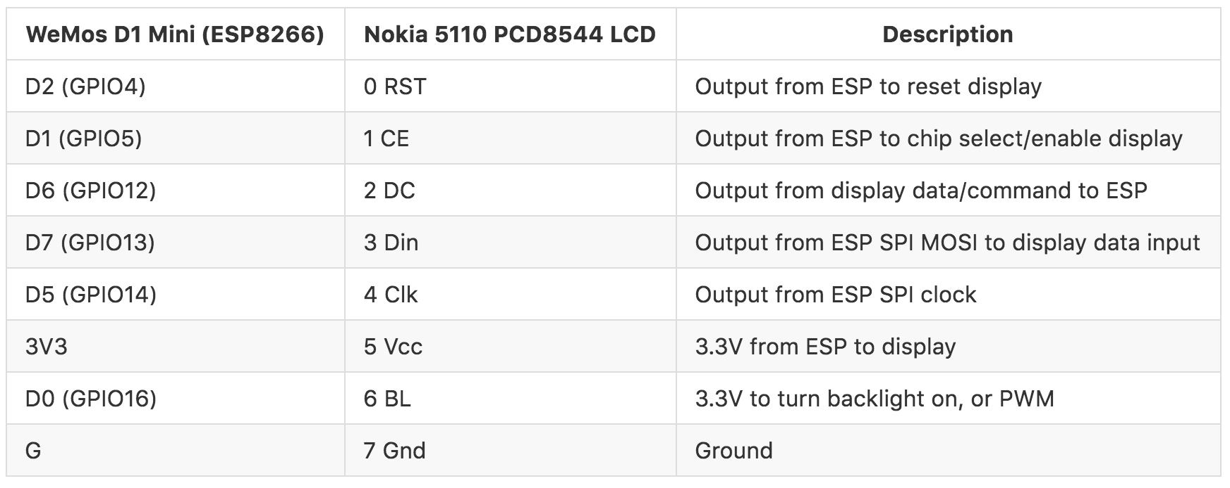
Connecting the Nokia 5110 LCD
github.com/mcauser/MicroPython-ESP8266-Nokia-5110-Conways-Game-of-Life
Notes:
I started with a 4 pin version of the ESP8266 (ESP-01) but I found the 14 pin version easier to workwith since I could wire the outputs directly.

Slide 17
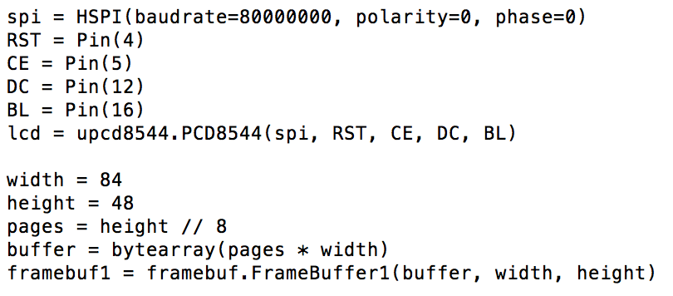
Setting up the Nokia 5110 LCD - setup_lcd.py
Notes:
SPI (spy) interface. machine library has both pin and HSPI modules
Upcd8544 driver library from mcauser

Slide 18
Writing to the LCD
Clear the display: framebuf1.fill(0)
Draw a pixel: framebuf1.pixel(x,y,1)
Write some text: framebuf1.text(“Hello!”, x, y, col)
lcd.data(buffer)

Slide 19

Let’s get some cats!
How do we draw cats on a 48x84 pixel monochrome screen?
Find a cat
Converts easily to back and white
Scales to something that fits in 48x84
Not super detailed

Slide 20

Create a cat image with ImageMagick
Get our cat onto a white background
convert hello_kitty.png -background white -alpha remove hello_kitty_white.png
2. Scale the cat
Original size: 503/503 ~ → 48/48
convert hello_kitty_white.png -resize 48x48 small_cat_paws.png

Slide 21
Convert the cat to a bitmap!
Using convert_png.py based on github.com/garybake/upython_wemos_shields
python convert_png.py small_cat_paws.png

Slide 22
111111111111111111111111110111111111111111111111
111111111111111111111111000001111100000111111111
111111110000011111111111001100000000000111111111
111111100000000111110000011110000111110011111111
111111100111100000000000111111001111110011111111
111111101111111000111100111000000111110011111111
111111101111111111111100110000000001000011111111
111111101111111111111100110000111000000001111111
111111100111111111111101111000111100111100111111
111111100011111111111100111101111100011100111111
111111100011111111111100000000111100011100111111
111111100111111111111111000110011000011100111111
111111100111111111111111111111000000111001111111
111111001111111111111111111111111001110001111111
111111001111111111111111111111111100000001111111
111111011111111111111111111111111111001100111111
111111011111111111111111111111111111111100111111
111110011111111111111111111111111111111100111111
111110011111111111111111111111111111110000000011
110000000111111111111111111111100111110000000111
110000000111100011111111111111100011111100111111
111111001111100011111111111111100011111000111111
111111001111100011111110111111100111111000001111
111110000011111111111000001111111111111000001111
111100000111111111111001001111111111111001111111
111111100111111111111100011111111111100001111111
111111110000111111111111111111111111110000111111
111111100001111111111111111111111111100000011111
111110001000111111111111111111111111000111111111
111110011110001111111111111111111000001111111111
111111111111000000111111111110000000111111111111
111111111111110000000000000000000011111111111111
111111111111111111000000000001111111111111111111

Slide 23
Image drawing - draw_image_from_text.py
for line in f:
for char in line:
if char == '0':
framebuf1.pixel(y,x,1)
gc.collect()
lcd.data(buffer)
gc.collect()
Notes:
Draw line by line to save memory. Tried to load into array and ran out of memory
After all the lines are read into the buffer, send to the lcd

Slide 24
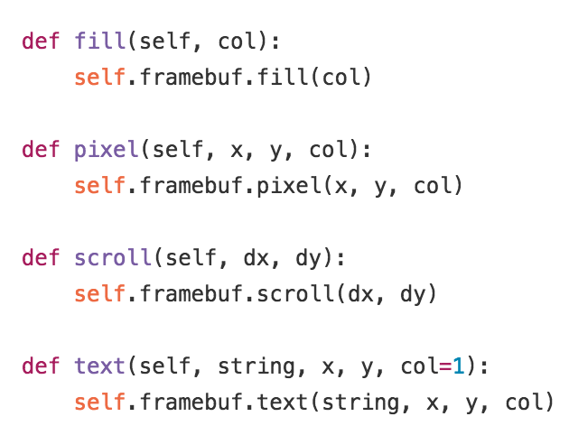
Framebuf interface reference
github.com/micropython/micropython/blob/master/drivers/display/ssd1306.py

Slide 25
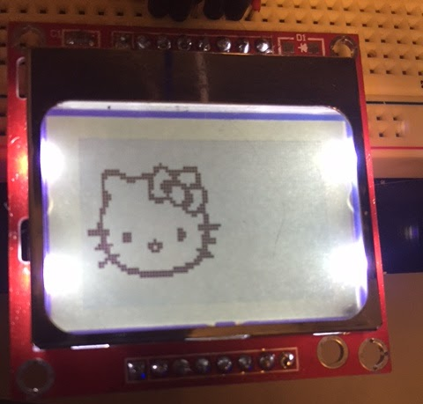
Lets draw a cat!
from setup_lcd import *
from draw_image_from_text import *
draw_image(‘hello_kitty.txt’, framebuf1, buffer, lcd)

Slide 26
Enable drawing on boot via boot.py
import gc
gc.collect()
from setup_lcd import *
from draw_image_from_file import *
gc.collect()
import webrepl
webrepl.start()
gc.collect()
Notes:
Boot.py - this will run when the esp8266 boots up
Becareful you dont brick your target!!

Slide 27

Potential boot.py weirdness

Slide 28
And now.. The INTERNET!
Setup an HTTP server to serve up our cats, enabling control of the LCD from THE INTERNET*
* As long as you are logged into the ESP8266
** Or if the ESP8266 itself is connected to the Internet
github.com/micropython/micropython/blob/master/examples/network/http_server_simplistic_commented.py

Slide 29
Processing the cat request
req = client_stream.readline()
req = str(req)
print(req)
if req.find('GET /cat=sitting') > 0:
lcd_cat = 'sitting_cat.txt'
draw_image(lcd_cat, framebuf1, buffer, lcd)

Slide 30
I can haz demo?

Slide 31
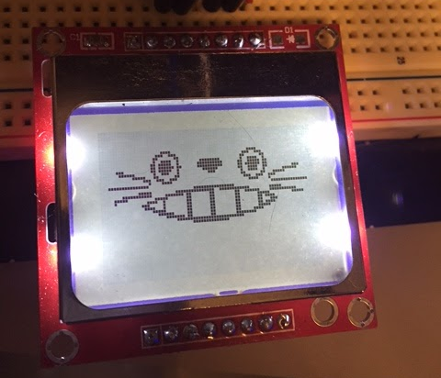
If not...
http://192.168.4.1:8080/cat=totoro
* technically not a cat

Slide 32
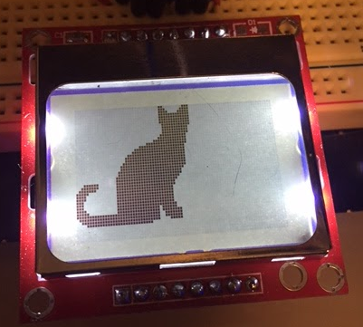
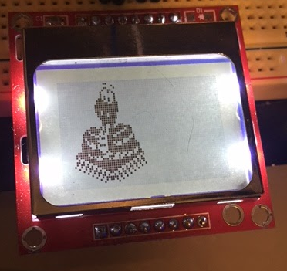
Moar cats and friends of cats!

Slide 33
Notable Mentions
Check your wires!!!!!! A multimeter is your friend
Steal liberally, but attribute!
Try a development board, like the pyboard or the Adafruit Feather HUZZAH ESP8266
Have you tried turning it on and off again?
Notes:
Wires… like trying to debug the display
Dont try to reinvent the wheel
Dev boards - i got my things because 1. A friend had them and 2. Because i wanted to find a low-cost solution that I could potentially make into a badge that people could put together for cheap

Slide 34
Thanks!
github.com/gizm00/pydx_upython
^ watch this space! ^
@gizm0_0
sev@thedatascout.com

